Slide 1
First year practicals
Lab 9&10: Attention and Inhibition of Return

Slide 2
What is attention?
“Everyone knows what attention is. It is the taking possession of the mind, in clear and vivid form, of one out of what seem several simultaneously possible objects or trains of thought. Focalisation, concentration, of consciousness are of its essence.” –James (1890), pp 403-404.

Slide 3
What is attention?
Attention is the process of concentrating on specific features of the environment, or on certain thoughts or activities. This focusing on specific features of the environment usually leads to the exclusion of other features of the environment.
Colman (2001)
But really “attention” is not a unitary concept
Luck & Vecera (2002), Styles (1997)

Slide 4
Types of attention
2 major sub-divisions in the psychology of attention
Focused (selective) attention
Divided attention
Attention
Focussed Attention
(process only one input)
Divided Attention
(process all inputs)
Auditory
(e.g. cocktail party effect)
Visual
(e.g. variable beam
spotlight)
Task
similarity
Task
difficulty
Practice

Slide 5
Visual Attention
It is often thought that we attend what we look at
However, we can process information to some extent even when our eyes are not directly focused on it
Attention may often precede eye-movements
So shifts in attention may be accompanied by a change in eye fixation or not
Overt & Covert shifts
‘Looking out of the corner of your eye’

Slide 6
Visual Attention
When we inspect visual stimuli or scenes, what controls the movement of attention?
Is attention captured by stimuli/objects or do we intentionally deploy attention?
In other words is attention controlled by us or by the stimuli?
Top-down processes versus bottom-up processes

Slide 7
Moving Visual Attention
‘Spotlight’ metaphor
One idea is that attention is like a spotlight which moves about and allows us to selectively attend to parts of the visual world
Michael Posner (1980) suggested that enhanced processing/detection occurs within this ‘spotlight’ [see also Norman (1968)]
So attention is directed towards ‘space’ according to the spotlight model. It is a space-based model of attention

Slide 8
Orienting Attention
Posner (1978), Posner (1980), Posner, Davidson & Snyder (1980) examined the effect of visually pre-cueing regions of space on detecting the presence of a potential target
They wanted to know whether causing a shift of attention to a specific location in space improved the processing of the subsequent stimulus
They examined covert shifts of attention
No eye-movements allowed!

Slide 9
Participants told to fixate here and not to look away

Slide 10
2

Slide 12
X

Slide 14
General Findings
Reaction times to detect the presence of a stimulus event are reduced compared to a control condition [no pre-cue given/uninformative pre-cue given (enlarged fixation cross)]
Presenting an informative pre-cue seems to allow attention to move to the correct spatial region and enhances processing at it

Slide 15
Investigating top-down and bottom-up control
Posner also manipulated the TYPE of pre-cue used in his task
Central cue (as in previous example, e.g. a directional arrow) or
Peripheral cue
A peripheral cue indicates exactly where the target stimulus may appear using a peripheral event which captures attention
E.g. an illuminated box (see next slides)

Slide 16
Peripheral Cue

Slide 17
Peripheral Cue

Slide 18
Peripheral Cue

Slide 19
Peripheral Cue
X

Slide 20
Peripheral Cue

Slide 21
General Findings – Peripheral Cue
Peripheral cues were found to orient attention too, with responses being faster [reaction times reduced] compared to a control (no cue) condition
So far the pre-cue has always been valid (i.e. 100% predictive of where the target will be, if it is presented)
So what happens if the pre-cue is invalid (doesn’t predict the location of the target) or uninformative (only predict target location on 50% of trials)?

Slide 22
Costs & Benefits
If the cue is 100% invalid
RT to detect target increases compared to a control/neutral condition
There is a cost to cueing attention to the wrong location!
Suggests that attention has moved in the wrong direction
If a peripheral cue is non-predictive/uninformative (only correctly predicts target on 50% of the trials) we still react faster to the cued location suggesting that peripheral cues cause REFLEXIVE shifts of attention
We can therefore examine the orienting of attention in terms of costs and benefits of cueing

Slide 23
Today’s Practical
We are going to use the Posner paradigm to examine another important finding in attentional research
How long does the facilitation effect of a valid pre-cue last?
Normally a valid peripheral pre-cue facilitates processing at and around that location
However, under certain conditions responses to a pre-cued location can be slowed down (inhibited)

Slide 24
Inhibition Of Return - IOR
The time-delay (cue-target-onset-asynchrony, CTOA) between presenting the cue and the target has to fall within certain parameters
If the delay is too large then attention moves away (is disengaged) from the location and any further processing at that location is temporarily inhibited, slowing down a response to a target that then later appears there
This reversal from a facilitatory to an inhibitory effect is called Inhibition Of Return [Posner & Cohen (1984)]
CTOA
CUE
ISI/cue-target interval
TARGET
Time

Slide 25
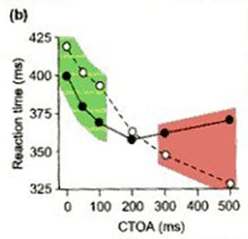
Manipulating CTOA
As the CTOA increases from 0 to approx. 200 ms, valid cueing is facilitatory
Between 200-300 ms the lines cross indicating that valid cueing now causes slower responses to the cued location
Black (filled circles) are valid trials
White are invalid trials

Slide 26
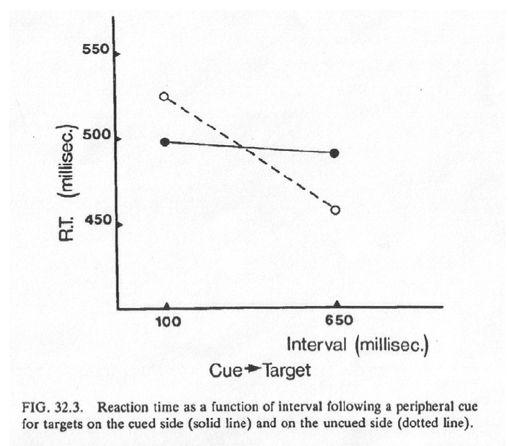
Posner & Cohen (1984)
Posner et al only found this inhibitory effect for peripheral pre-cues i.e not for central cues!
Cued (valid)
Uncued (invalid)

Slide 27
Another IOR definition
IOR is “…a reduced perceptual priority for information in a region that has recently enjoyed a higher priority”
Samuel & Kat (2003), p897.

Slide 28
Our experiment
We are going to manipulate 3 levels of CTOA and investigate differences between them.
We will use CTOA’s of 150, 200 and 400 ms
Our null hypothesis will be that facilitation is not affected by CTOA
Our experimental hypothesis will be that as CTOA increases, facilitation decreases

Slide 29
Measuring size of the effect
We can measure the size of the facilitatory effect by taking a difference score for valid and invalid trials
Difference score = RT Invalid – RT Valid
E.g for a short CTOA (say 50ms) we expect people to be faster on valid trials than invalid ones (a facilitatory effect) by say 25 ms.
405 - 380 = +25ms (facilitatory effect of cueing)

Slide 30
Example Data
IOR begins to take effect around here
+
RT difference (msecs)
Facilitation
CTOA
100
200
300
400
Inhibition
-
As CTOA increases, facilitation decreases

Slide 31
What role might an IOR mechanism have?
IOR biases attentional orienting away from previously inspected locations
When we visually search an environment, we want to avoid re-inspecting (attending) already visited locations/objects.
IOR prevents us returning to recently inspected locations using an inhibitory mechanism
We have a bias towards new/un-inspected locations
Klein (1988)- IOR can facilitate effective visual search / foraging behaviour

Slide 32
OK, so that’s the theory
Let’s look at building this experiment in PsychoPy and collecting some data.
Experiment
Peripheral cueing task
Task: Decide whether an X appears at one of 2 possible locations
If it does then press SPACE
If it doesn’t then don’t press anything
Target detection task vs. a discrimination task

Slide 33
Design
Factors to control/manipulate
% of trials when target is present/absent
Location of pre-cue (Left or Right)
Location of target [when present] (Left or Right)
Cue-target onset asynchrony (150, 200 & 400ms)
Manipulate this as a within-subjects IV (3 levels)

Slide 34
Minimum trials to control and manipulate all variables
2 (present/absent) x 2 (Cue L/Cue R) x 2 (Target L/Target R) x 3 ( CTOA 150, 200 & 400) =
24 trials for a balanced design
So we can use any multiple of 24 for the number of experimental trials
These trials break down into valid and invalid trials
Valid trials
Target appears in the cued location
Invalid trials
Target appears in the uncued location

Slide 35
Time to build!
Ok, so we are going to build a peripheral cueing task in PsychoPy!
This is going to be more involved and will teach you some new PsychoPy skills
+
VALID
+
+
+
OR
50:50 ratio
FIX
CUE
Variable ISI
+
INVALID
Target

